Slide 1
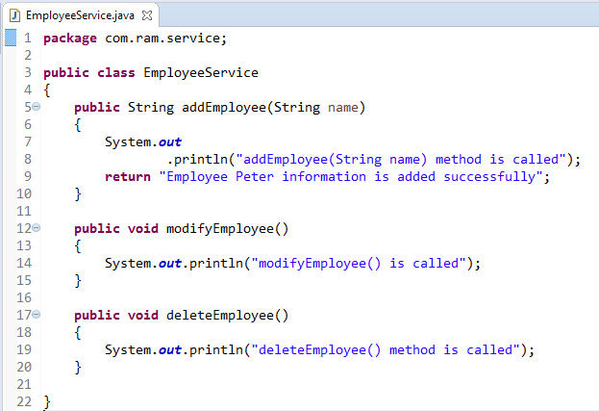
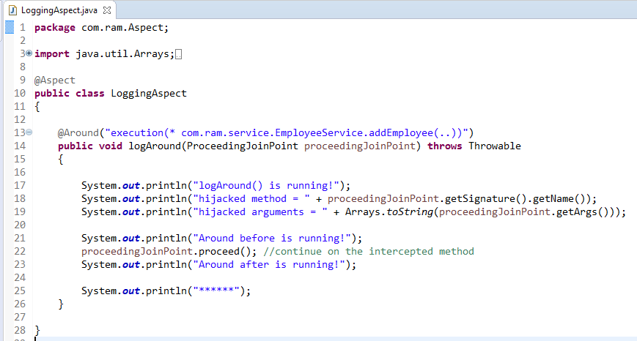
AspectJ @Around
@Around declares the around advice.it is executed before and after the actual method call.
@Around
method
AspectJ “pointcuts” is used to declare which method is going to intercept
@Around
2
1
3

Slide 2
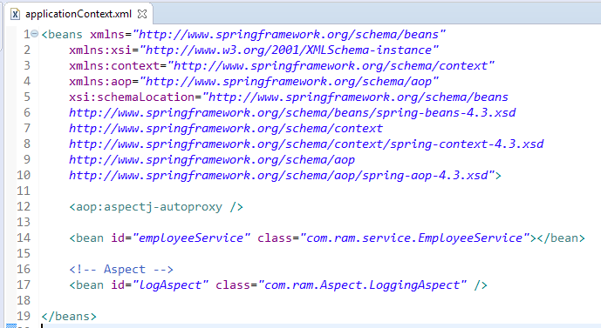
To Enable AspectJ, In Spring configuration file, put “<aop:aspectj-autoproxy />“, and define your Aspect (interceptor) and normal bean

Slide 3
